Slide 1

Automation Testing
By- Manas

Slide 2
What is XPath?
XPath is defined as XML Path
XPath is unique locator of the element in application
Xpath is a syntax or language for finding any element on the web page using XML path expression
Xpath is used to find out the location of element on a webpage using HTML DOM Structure/HTML Tree Structure.

Slide 3
Types of XPath
There are two types of XPath:
Absolute XPath
Relative XPath

Slide 4
Absolute XPath
Identify the exact location of the element in HTML page from html tag to till the element.
Full path from the root (html) to the element
It begins with forward slash (/), which means you can select the element from the root node
Below is the example of Absolute Xpath expression of the element.
Ex. /html/body/div[1]/div[2]/div[1]/div/div/div/div[2]/div/div[1]/form/div[1]/input

Slide 5
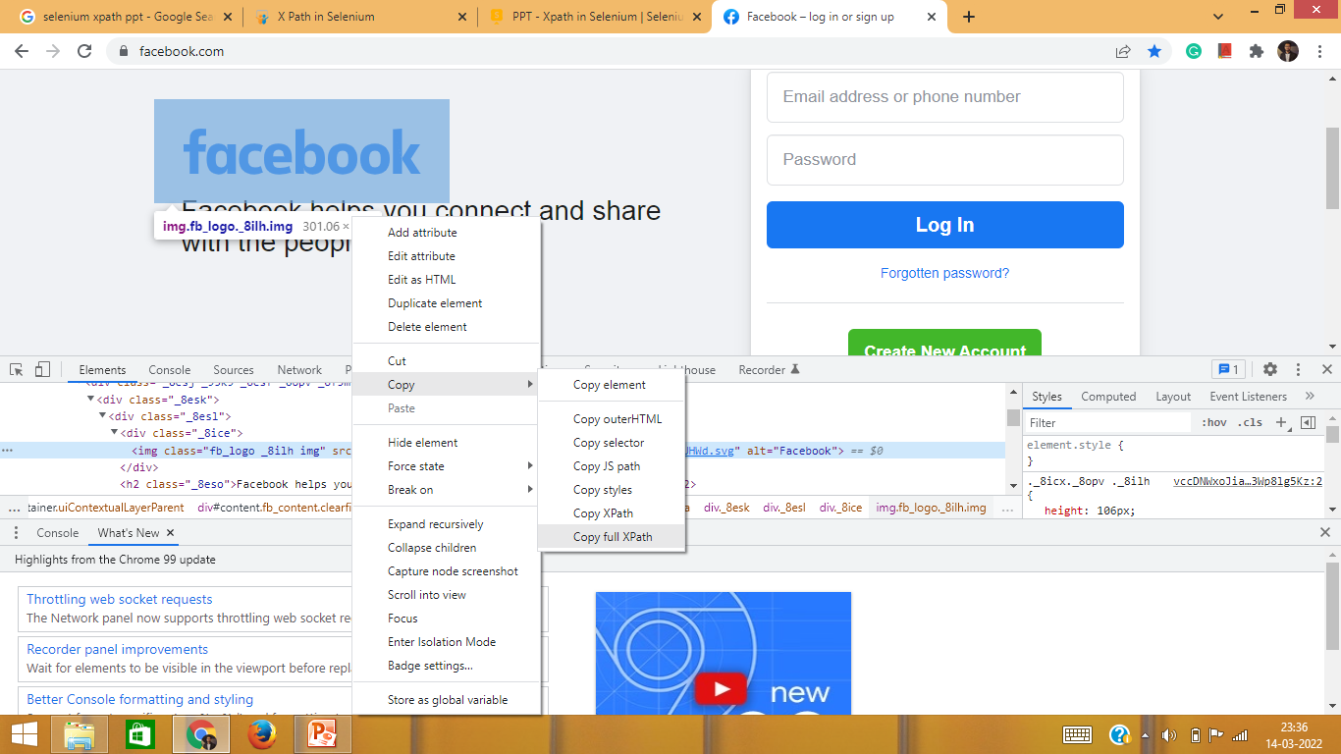
Absolute XPath:

Slide 6
Relative XPath
Relative XPath find out the element based on the unique locators
For Relative Xpath path starts from the anywhere in the HTML DOM Structure (not root).
It start with double forward slash (//) which means it can search the element anywhere at the webpage.
Below is the example of Relative Xpath expression of the element.
Syntax: //Tagname[@locator=‘value’]
Ex: //input[@name=‘username’]

Slide 7
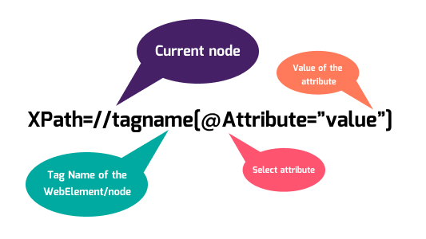

Slide 8
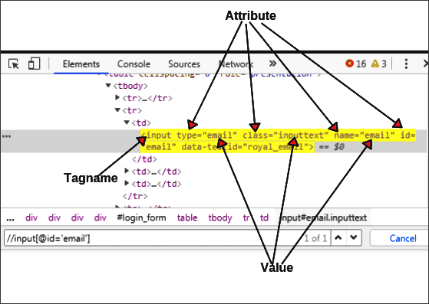

Slide 9
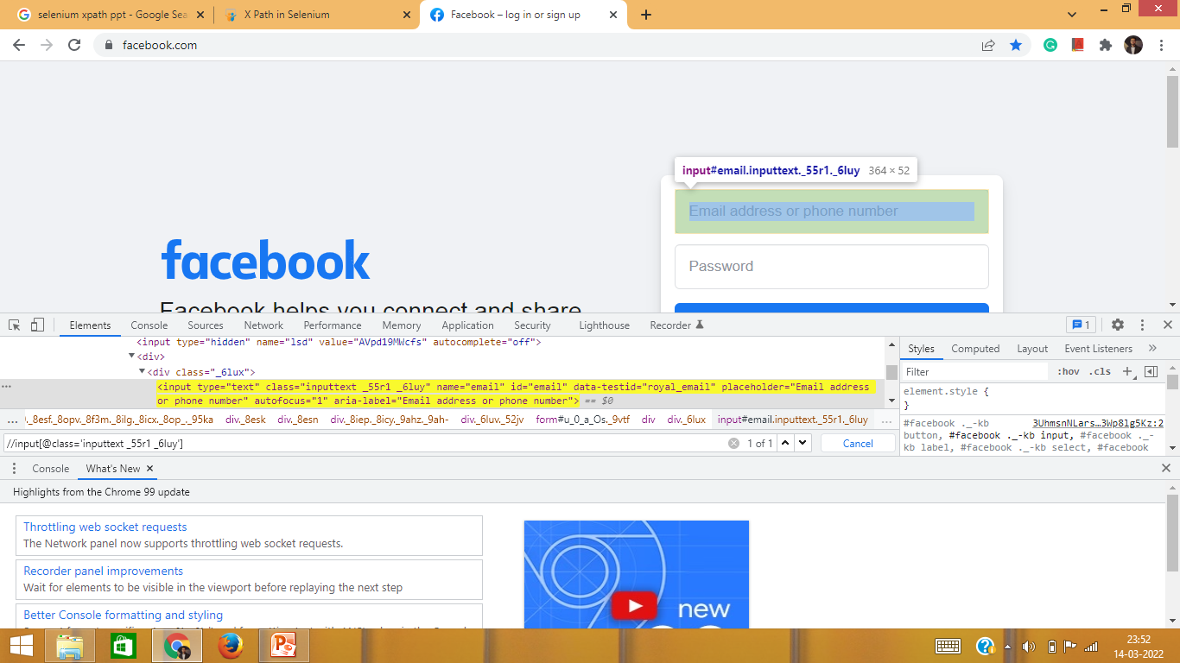
Relative Xpath:

Slide 10
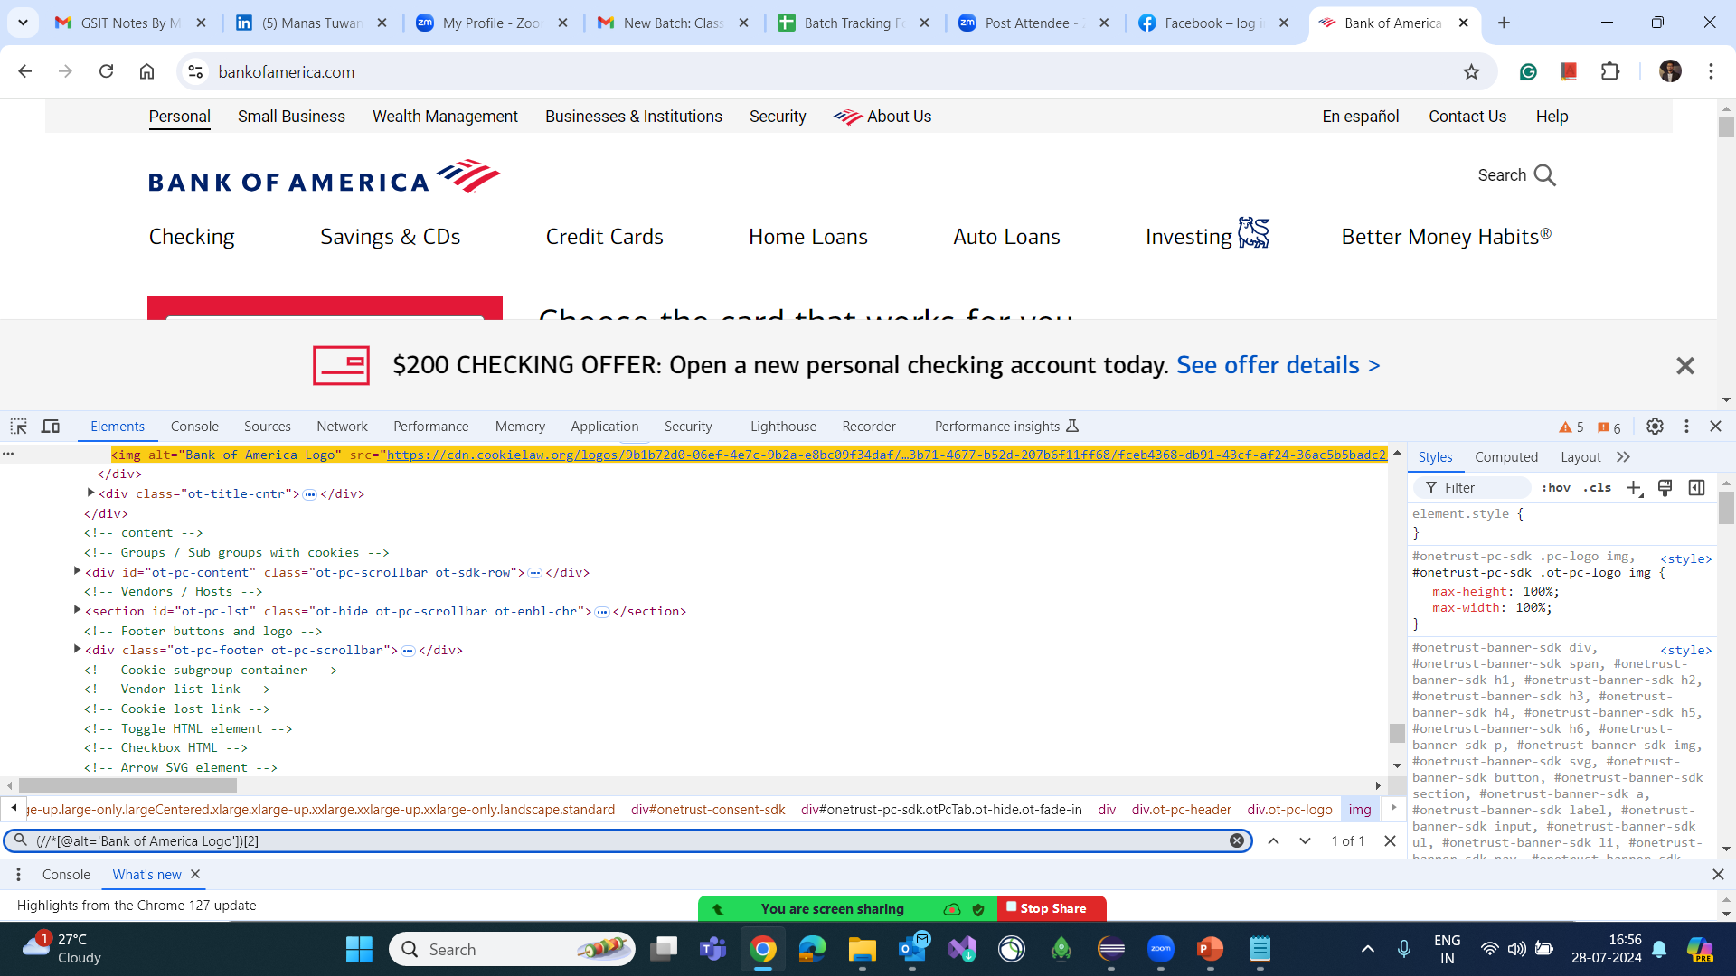
Xpath Indexing

Slide 11
Difference Between Absolute XPath and Relative XPath
Absolute XPath | Relative XPath
Identify the exact location of the element in HTML page from html tag to till the element. | Relative XPath find out the element based on the unique locators
It begins with forward slash (/) | It start with double forward slash (//)
Not preferable in real time project. | Always preferable in real time project.
Example: /html/body/div[1]/div[2]/div[1]/div/div/div/div[2]/div/div[1]/form/div[1]/input | Example: //input[@name=‘username’]

Slide 12
Note:
/ It specifies that selection starts from the root node.
// It specifies that selection starts from the current node that match the selection.
@ Selects any attributes/locators.

Slide 13
XPath Expression and Logic
Basic Expression: //Tagname[@locator=‘value’]
AND Logic: //select[@id=‘day’ and @name=‘dayname’]
OR Logic: //select[@id=‘day’ or @name=‘dayname’]
Starts-with Logic: //select[starts-with(@id, ‘day’)]
Contains Logic: //select[contains(@id, ‘a’)]

Slide 14
XPath Axes
Ancestor: Identify the parent and grandparent group
//select[@id=‘day’]/ancestor :: *
//select[@id=‘day’]/ancestor :: div
Preceding: Before this element how many elements are there
//select[@id=‘day’]/preceding :: *
Requirement: Before this element user would like to count the number of links
//select[@id=‘day’]/preceding :: a

Slide 15
Xpath Axes
Following: After this element how many elements are there
//select[@id=‘day’]/following :: *
descendant: In this element how many sub-elements are there
//select[@id=‘day’]/desendant :: *

Slide 16
FAQ’s
What is Xpath?
Why Xpath is unique locator?
What are the different types of Xpath?
Difference between Absolute and Relative Xpath
Write the Syntax for Relative Xpath
Difference between “/” and “//”
Difference between Preceding and Following keyword.

